Slide 1
-TITLE-
E- Commerce website
for clothing shop
Using React JS + Spring Boot Microservices + MySQL
Presented By: 1. Atharva Shrivastava (230341220038)

Slide 2
-INTRODUCTION-
The purpose of this document is to outline the software requirements for an E-commerce Clothing Website
that will provide a platform for users to browse and purchase clothing products online.
The system will be developed using Java for backend development, ReactJS for frontend development, Spring Boot
as the application framework, MySQL for database management, and the Razorpay payment gateway for processing transactions.

Slide 3
-OBJECTIVES-
The purpose of this document is to outline the software requirements for an E-commerce Clothing Website
that will provide a platform for users to browse and purchase clothing products online.

Slide 4
-TECHNOLOGY USED-
Java - Spring Boot Microservices
React JS
MySQL
Maven
BootStrap

Slide 5
-SOFTWARE USED-
STS (Spring Tool Suite
VS Code (Visual Studio Code)
MySQL Workbench

Slide 6
-USER MODULES-
1) User Registration and Authentication
2) Product Browsing and Searching
3) Product Details
4) Shopping Cart
5) Checkout and Payment
6) User Profiles

Slide 7
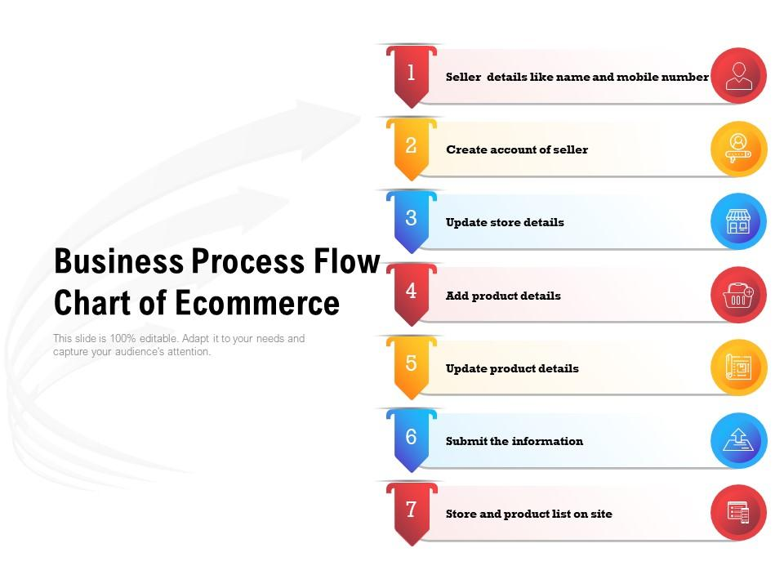
-PROJECT OVERVIEW-

Slide 8
-BACKEND STRUCTURE-
Employee Management System Spring Boot Microservices:
1) API Gateway Service
2) Service Registry Service
3) User Service
4) Security Services
5) Performance
6)Scalability

Slide 9
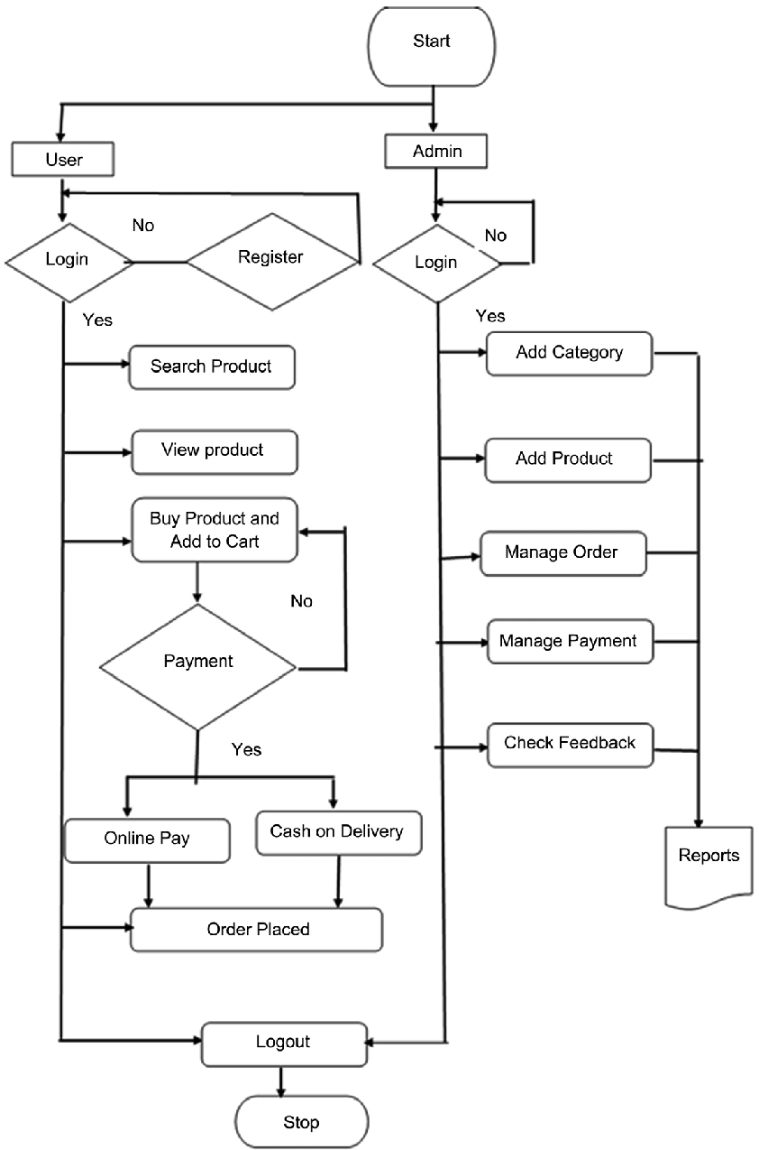
-PROJECT FLOW-

Slide 10
-CONCLUSION-
This Software Requirements Specification outlines the key features and functionalities of the E-commerce Clothing Website.
It provides a clear understanding of what the system aims to achieve and the technologies it will employ.
The successful implementation of this project will result in a fully functional and user-friendly online platform for purchasing clothing items.

Slide 11
Thank You

